Slide 1
Introduction to Decentralized Finance
Programming in Python

Slide 2
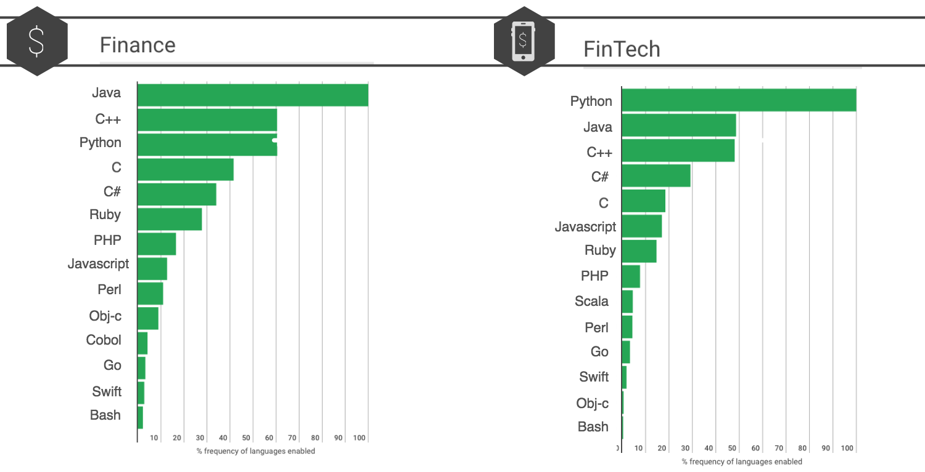
Why Python?
Python is a very popular programming language in the finance industry.
It is probably the most popular in FinTech.

Slide 3
Why is Python popular?
Ease of use for beginners
Quick application development time
Plenty of online learning resources
Extensive data visualization support
Open-source libraries
Python is being used by leading companies in a variety of fintech fields.
For example, Bank of America’s Quartz and J.P. Morgan’s Athena platforms both use Python. Big companies like Google, Facebook, Instagram, and Spotify also use Python in their development. Many other companies like Citigroup require their data analysts to master Python and take training classes for the language. Some companies ask about knowledge of Python during interviews.

Slide 4
COLAB
We will use Google COLAB to create and run Python codes
To start, open your browser and type “https://colab.research.google.com/”
Then click on “New Notebook”
This opens a new notebook where we will write and execute Python codes

Slide 5
Basic Python platform and Libraries
Basic Python contains commands for elementary operations.
The powerful functionality of Python programming language comes from Libraries that are integrated with the Python platform.
A library contains advanced operations specialized for a particular task. For example, library ‘Matplotlib’ contains commands to generate graphs.
If we want to use a library, we need first to install it in our computer. This needs to be done only once. Then, every time we want to use the library, we just need to import it.
In COLAB, many libraries are already installed. However, if we would like to use other libraries that are not automatically installed, we need to install them.

Slide 6
How to “install” and the “import” a library
Suppose that we would like to install a library called ‘NumPy’. In the command box of COLAB Notebook we type
pip install numpy
Once installed, to use the library ‘NumPy’ we simply import it in our code with
import numpy as np
The library ‘NumPy’ has many commands we can use in our program. All commands can be called with
np.___
where ___ contains the key word that calls the desired command.
For example, to create a three-dimensional array containing all zero, we write
np.zeros(3)

Slide 7
Three important liabraries
NumPy (import numpy as np)
Pandas (import pandas as pd)
Matplotlib (import matplotlib.pyplot as plt)
Useful codes can be found at:
https://github.com/PacktPublishing/Hands-on-Python-for-Finance/tree/master/Chapter%202

Slide 8
1. NumPy
NumPy is a library that is used in Python to create single and multidimensional arrays and matrices. It also contains functions that perform mathematical operations on these arrays.

Slide 9
NumPy: Creating an Array
Creating a two-dimensional array
Array1=np.array([[11,12,13],[14,15,16],[17,18,19]])
Array2=np.array([[1,2,3],[4,5,6],[7,8,9]])
Using function “arange” or “linspace”
Array3=np.arange(0,10,2)
Array4=np.linspace(0,8,5)

Slide 10
Using function “zeros”, “ones”, “eye”
Array5=np.zeros((2,3))
Array6=np.ones((2,3,4))
Array7=np.eye(6)
Using function “rand”
Array8=np.random.rand(2,3)

Slide 11
NumPy: Indexing an Array
Indexing an element of the array (Index starts at zero)
Array1[1,2]
Slicing the array
Array1[:1,:2]
Array1[1:,2:]

Slide 12
NumPy: Operations
Summing and multiplying
Array1+Array2
Array1*Array2
Square root and exponential of the elements of the array
np.sqrt(Array1)
np.exp(Array1)
Maximum element of the array
np.max(Array1)

Slide 13
2. Pandas
The library provides one of the most important tools for data analysis. It is built on top of NumPy. It allows you to work with data from a variety of sources, such as CVS, Excel, HTML, etc.

Slide 14
Pandas: DataFrames
DataFrames is a data structure typically with a two-dimensional shape consisting of rows and columns. We can think of a DataFrames as many series (variables) put together and sharing the same index.
A DataFrames in pandas can be created using:
pandas.DataFrames(data, index, columns, dtype, copy)

Slide 15
Creating a DataFrame
dataset=pd.DataFrame(np.ones((4,5)),index=[‘P’ , ‘Q’ , ’R’ , ’S’],columns=[‘A’ , ’B’ , ’C’ , ’D’ , ’E’])
Retrieving the series values by indexing
dataset[‘A’]
dataset[[‘A’ , ’B’]]
Creating new columns with arithmetic operations
dataset[‘F’] = dataset[‘A’] + dataset[‘B’]
dataset[‘G’] = dataset[‘A’] - dataset[‘B’]

Slide 16
Dropping a column
dataset.drop(‘F’,axis=1)
dataset.drop(‘F’,axis=1,inplace=True)
Dropping a row
dataset.drop(‘P’, axis=0)
dataset.drop(‘P’, axis=0 , inplace=True)

Slide 17
Selecting rows in the dataset
dataset.loc[‘Q’] (selection based on label)
dataset.iloc[0] (selection based on position)
dataset.iloc[: , :-1] (selection a subset based on position)
dataset.iloc[:2 , 1:3] (selection a subset based on position)
dataset.loc[‘Q’ , ’A’] (selection based on label)
dataset.loc[[‘Q’ , ’R’],[’B’ , ’C’]] (selection based on label)
Conditional selection
dataset>0
dataset[dataset>0]
dataset[(dataset[‘A’]>0) & (dataset[‘B’]>0)]

Slide 18
yfinace: Market data from Yahoo!
It is an API (Application Programming Interface) that allows to upload market data for many securities including cryptocurrencies

Slide 19
We first need to install yfinace:
pip install yfinance
Next we need to import the libraries in Python:
import yfinance as yf
We also import the following:
import datetime as dt
import matplotlib.pyplot as plt

Slide 20
Python instructions for using yfinace
Set the initial and final date for data extraction:
start = dt.datetime(2000,1,1)
end = dt.datetime.now()
Download data for bitcoin, ether and tether:
btc = yf.download('BTC-USD', start, end, progress=False)
tet = yf.download('USDT-USD', start, end, progress=False)
Show downloaded data:
btc.head()
Plot prices for bitcoin and ether at Adjusted Close:
btc[‘Adj Close'].plot(title="Bitcoin price")
plt.show()

Slide 21
Download data for some stocks: Tesla, Amazon, Goldman Sachs
tsl = yf.download('TSLA', start='2020-01-01', progress=False)
amz = yf.download('AMZN', start='2020-01-01', progress=False)
gs = yf.download('GS', start='2020-01-01', progress=False)
Plot price for Tesla:
tsl[‘Adj Close'].plot(title="Tesla price")
plt.show()
Download data for some currencies: Euro, Canadian Dollar , Brazilian Real
eur = yf.download('EURUSD=X', start='2020-01-01', progress=False)
cad = yf.download('CADUSD=X', start='2020-01-01', progress=False)
br = yf.download('BRL=X', start='2020-01-01', progress=False)
Plot exchange rate of Brazilian Real:
br[‘Adj Close'].plot(title=“Exchange rate Brazilian Real - USD")
plt.show()

